Slide 1
Prolog
Lab 1

Slide 2
Logic programming
Logic programming is a programming concept like object oriented programming.
Think like human brain.
Has knowledge and from this knowledge can conclude new things (Reasoning).
Instead of writing a lot of facts, we can use rules to conclude new information from previous known facts.
Can learn.
In logic programming, program is given a set of facts and rules from them can conclude what action should be taken.

Slide 3
Languages: Prolog and LISP are languages of logic programming, we will study Prolog.
Tools: Visual Prolog 5.2
Notes:
Installation:
----------------
Right click on “vip52pe.exe” icon and press “Run as Administrator”.
Continue with the setup.
Finally, open “Vip32” from start menu

Slide 4
Applications of logic programming
Expert systems.
Natural language processing.
Games (like chess).
Semantic networks.

Slide 5
Objects in Prolog
Objects
Values
Simple
Structured
Variables
Free
Bound
Integer
Real
Char
String
Symbol
List
Tree
Graph
Has no Value
Has a Value
Notes:
Symbol is the same as String but without double quotes and no special characters or spaces are allowed.

Slide 6
Variables in Prolog
Free variables | Bounded variables
Has no value | Has value
If we used equal sign “ =“ means we want to give this variable a value | If we used equal sign “ =“ means we want to compare the value of this bounded variable with the value given
Takes its value just ones, then can not be changed (except in backtracking) | Its value can not be changed (except in backtracking)

Slide 7
Prolog Syntax
Any prolog program is a collection of facts and rules forming a knowledge base (or a database).
These facts and rules describe some collection of relationships.
To use a prolog program, ask questions about the information stored in the knowledge base.

Slide 8
Facts
Something that is always unconditionally true.
Ex:
Ali is a boy.
Ahmed likes Ali.
Syntax:
boy(ali).
likes(ahmed, ali).
ahmed and ali are values of type symbol.

Slide 9
Rules
True if some conditions satisfied.
Ex:
Ahmed likes X(someone), if X is a boy and Ali likes X.
Syntax:
likes (ahmed, X):-
boy(X),
likes(ali, X).

Slide 10
Program Structure
Any program of prolog must contain three sections:
predicates: declaration of facts and rules.
clauses: implementation of facts and rules.
goal: A question that needs an answer.
Prolog starts execution from goal, like in C++ program starts from main() function.
Notes:
Now it’s time to learn how to write a program in prolog

Slide 11
Example
Predicates
boy(symbol)
girl(symbol)
likes(symbol,symbol)
sister(symbol,symbol)
clauses
boy(ali).
boy(kareem).
boy(ahmed).
girl(fatma).
girl(mona).
sister(fatma, kareem).
sister(mona, ahmed).
likes(ali, kareem).
likes(ahmed, X):-
boy(X),
likes(ali, X).
likes(ahmed, X):-
sister(X, ahmed).
goal
boy(ahmed).
%boy(X).
%likes(ahmed, Z).
%likes(X, Y).
% for single line comment.
/* */ for multi lines comment.

Slide 12
Notes
Predicates:
It doesn’t matter to be ended with dot.
Clauses:
It must be grouped by type.
It must be ended with dot.
In conditional statement we write the result first then :- then all conditions separated with comma.
Semicolon ; means OR.
Variable must start with Capital letter or underscore followed by letters.
Variable scope is in its rule only.
Goal:
Must be one and ended with dot.

Slide 13
Matching and Backtracking
Prolog finds its goal by matching and backtracking.

Slide 14
Matching
1) Bound value, bound value → Comparison
Ex: goal
boy(ahmed).
Stops when it finds a match and returns yes.
Yes/No question.

Slide 15
Matching
2) Free variable, bound value → Assignment.
Ex: goal
Boy(X).
Gets all solutions.
What questions.
3) Free variable, free variable → pass by reference.

Slide 16
Backtracking
Get all possible solutions for a variable to make the goal true, we test all combinations of the conditions of a certain rule, so we get all possible solutions that make the rule true.

Slide 17
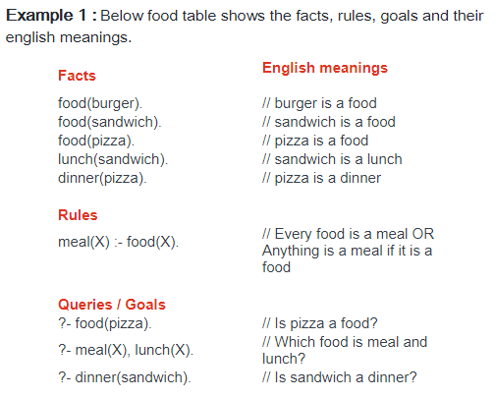
Notes:
Reference:
http://athena.ecs.csus.edu/~logicp/prolog/programming-examples.html

Slide 18
Example 2
ahmed and ali are boys.
sarah and mai are girls.
arabic, English and math are subjects.
Ahmed study Arabic.
Ali study any subject that ahmed study.
Any girl study English.
Math can be studied with either girls or boys.
Goal:
What does sarah study?
Who study Arabic?
Who study math ?

Slide 19
Solution of example 2
predicates
nondeterm boy(symbol)
nondeterm girl(symbol)
nondeterm subject(symbol)
nondeterm study(symbol, symbol)
clauses
boy(ahmed).
boy(ali).
girl(sarah).
girl(mai).
subject(arabic).
subject(english).
subject(math).
study(ahmed, arabic).
study(ali, X):-
study(ahmed, X).
study(X, english):-
girl(X).
study(X, math):-
girl(X); boy(X).
goal
study(sarah, X).
%study(X, arabic).
%study(X, math).
%in the last goal ali will be appeated because of the clause in blue color.

Slide 20
Example 3 (Your turn ;))
Banana is a yellow fruit, pineapple is a yellow fruit, orange is an orange fruit and tomato is a red fruit.
Cucumber is a green vegetable, carrot is an orange vegetable and tomato is a red vegetable.
Sarah and Amira are girls.
Ali and Ahmed are boys.
Sarah likes bananas and likes any fruit.
Amira likes any fruit that has orange color.
Ali likes any green vegetables.
Ahmed likes any food that is considered as a fruit and vegetable at the same time !!
GOAL
1. Who likes banana ? 2. What does Sarah likes ?
3. What dose Amira likes ? 4. What dose Ahmed likes ?
5. Who likes fruits with orange color ? 6. Does Ali likes cucumber? 7. What does Sarah and Amira likes in-common?

Slide 21
Thank You

